Slide 1
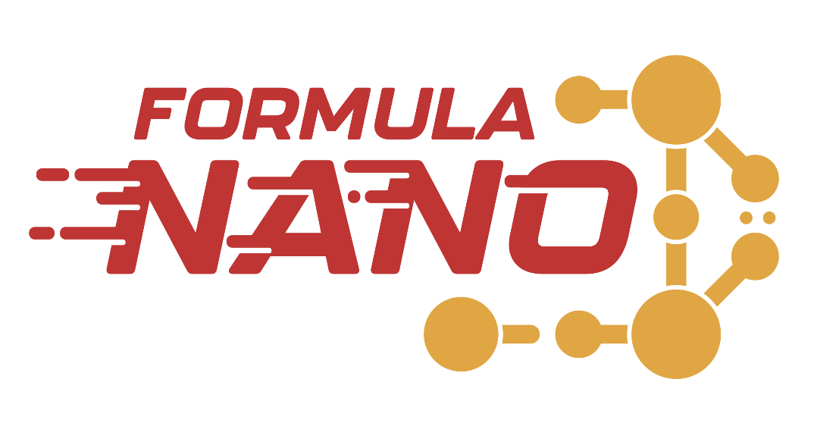
Formula Nano
University of Waterloo
Qchem Architecture
July 16, 2025

Slide 2


What is Qchem?
Python Library for Formula Nano
Accessible through :
GitHub : https://github.com/UWFormulaN/qchem
PyPi (pip install qchem)
Used by Formula Nano for :
Running Calculations
Processing Results
Graphing and Displaying

Slide 3
QChem Design Philosphy
Goals for QChem
Easy to use
Extensible - New functionality on your local copy
Automate Processes
Used on any device
Current version needs a rewrite to improve upon these goals
Core ideas will be kept
Most of it needs to go in the trash
Better design needed with the full context upfront

Slide 4
QChem Design Patterns
OOP Pattern (Object Oriented Programming)
Abstraction
Classes
Interfaces
Objects
Allows for
Seperation of Concerns
Extensibility through :
Polymorphism
Inheritance
Easy to Modify and Expand
Notes:
The Qchem library makes use of Object Oriented Programming
Object Oriented Programing allows us to introduce abstraction into our code using Classes and Interfaces to populate the behaviour of Objects
By using this design pattern we can ensure the following :
there is a separation of concerns, meaning that 1 file, has 1 class and that takes care of a single behaviour or process, an example of this that will be shown later is the XYZFile Class
It also makes our code more extensible through Polymorphism and Inheritance, this means that Objects can share behaviours without code duplication, you can add new features quickly and you can make custom code without modifying the main library
In the long run, using the Object Oriented Programming pattern it will make it easy to add features to the library down the line

Slide 5
What is OOP?
Style of Programming using ``Objects``
Created from a ``Class``
Blueprint
Properties (Variables)
Methods (Functions)
Allows for :
Self Contained Code (Seperation of Concerns)
Abstraction and Polymorphism (Extensibility)
Less Duplication (Inheritance)
Notes:
Now, Object Oriented Programming is a programming style that uses Objects
An Object is created from a Class, which is like a blueprint defining a Objects structure with Properties and Methods

Slide 6
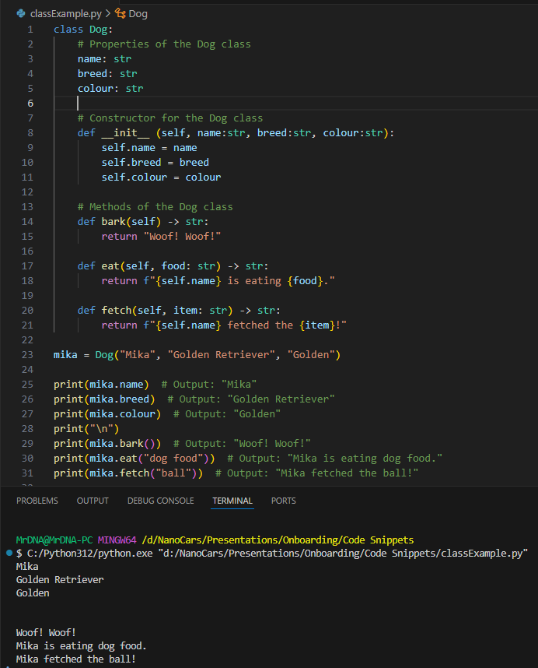
OOP Example
Example Class Definition : Dog
Properties (Variables)
Name
Breed
Colour
Methods (Functions)
Bark
Eat
Fetch
Object Created and then used
Notes:
A common way to teach Object Oriented Programming is by using Animals as an Example
A basic Class we can make is a Dog,
A Dog will have a Name, Breed and a Colour,
And a Dog will typically Bark, Eat and can Fetch an Item
We can then easily create the object and then access it’s properties and

Slide 7
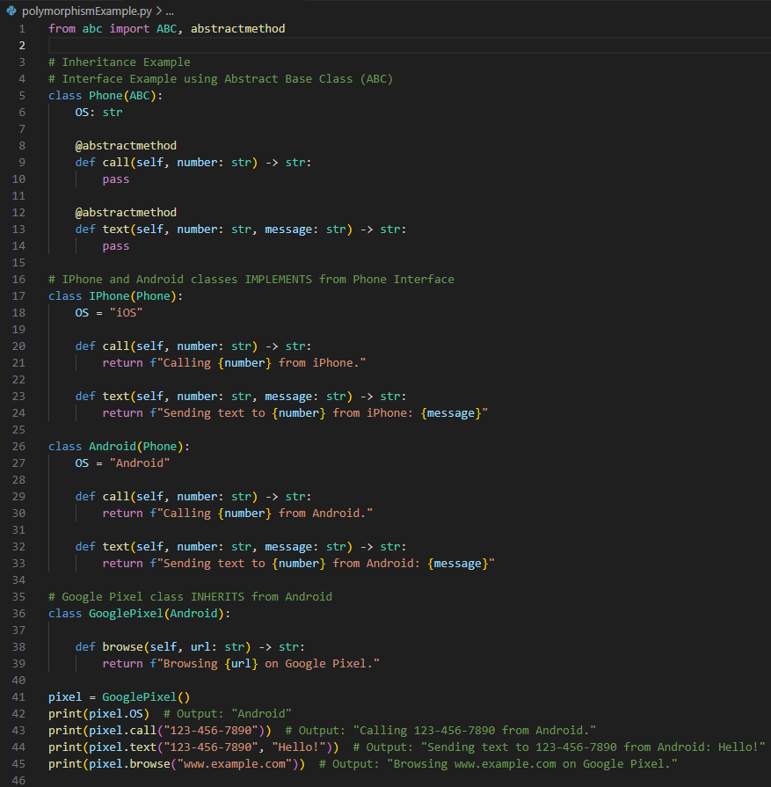
Interfaces : Inheritance and Polymorphism
Interfaces
Contract for a Class
Properties
Methods
Inheritance
Shares Behaviour between Classes
Polymorphism / Abstract Classes
Method of Inheritance
Override Methods
Visual Studio Code Examples
Notes:
Now, we need to learn some Polymorphism basics
Polymorphism is built off of Interfaces. Interfaces define a Contract with classes that inherit them. This means that a class that inherits from an interface must implement the properties and methods defined by the Interface.
Now Interfaces don’t really exist in Python, but we can simulate similar behavior
Just as the name suggests, Inheritance allows for classes to adopt the functionality of another class. This is how we can minimize code duplication and share common functionality between classes
And now Polymorphism, is a form of Inheritance that lets us override the functionality of a class.
Lets go through examples displaying this, common ways to show this is through Phones and Animals

Slide 8
Why is OOP Practical?
Most Software and Libraries use OOP
Python, C++, C# and other Languages
Numpy, Pandas, MatplotLib
Reduces context overloading
Less Variables to keep track of
1 Variable = 1 Object (Holds data and behaviour)
Makes code more reusable
Classes can be reused across projects
Inheritence lets you extend functionality
Easier to maintain
Changes only happen within the class
Better modular design and easy to test
Notes:
So, now after going through these examples, the reasons that OOP is practical and what we should use are as follows
Most Softwares, Libraries and languages use OOP Patterns, for example Numpy, Pandas and Matpotlib
There is less to keep track of, instead of tracking down all the variables in your script, there is just one, and you can access the ones that belong together through the parent object.
For example, with a Car, you can access car.color, car.brakes, car.brand
OOP patterns also make your code much more reusable. This means you will need to write less code in the future, others can improve upon you work by extending the functionality or working upon it.
Last of all, it makes everything much easier to maintain, all feature changes are subject to one file and or class. And it makes it extremely easy to unit test to make sure it works.

Slide 9
QChem Library
Visual Studio tour of the Library
Notes:
Now you may not be sold on OOP, and you have every right to be. But let me show you an example that may convince you
Some advn

